Slide 1
CLOUD DEVOPS PROJECT
TITLE:
Configure the Jenkins to send a personal email alert and develop a git based Infrastructure Management with Terrform.
TEAM MEMBERS:
2200032598 - Amrutha
2200031272 - Vishnu Vardhan
2200080014 – Pallavi
2200030362- Harika

Slide 2
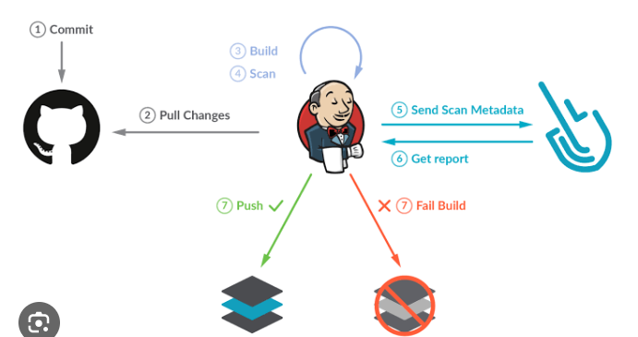
Automated Infrastructure with Jenkins, Terraform, and Git
This presentation outlines how to automate infrastructure management using Jenkins, Terraform, and Git. We'll cover setting up personalized email alerts from Jenkins, developing a Git-based infrastructure management workflow, and the key concepts behind each tool. This combination enables efficient, auditable, and repeatable infrastructure deployments.

Slide 3








Jenkins Configuration for Personal Email Alerts
Install Email Extension Plugin
Navigate to Jenkins Plugin Manager and install the "Email Extension Plugin" for advanced email functionalities.
Configure System Email
In Jenkins system configuration, set up the default system email address and SMTP server details for sending emails.
Define Email Content
Customize email templates for different build outcomes (success, failure) with details like build logs, status, and commit information.
Set up Trigger Conditions
Configure email triggers based on build events such as build failure, unstable builds, or successful completion.
Jenkins can be configured to send personalized email alerts for build status. Using the Email Extension Plugin, you can customize the email content and trigger conditions, such as sending a failure notification directly to the committer.

Slide 4

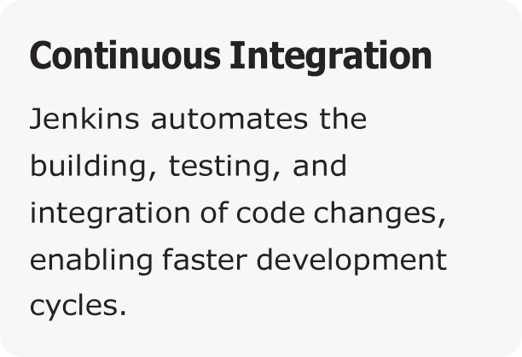
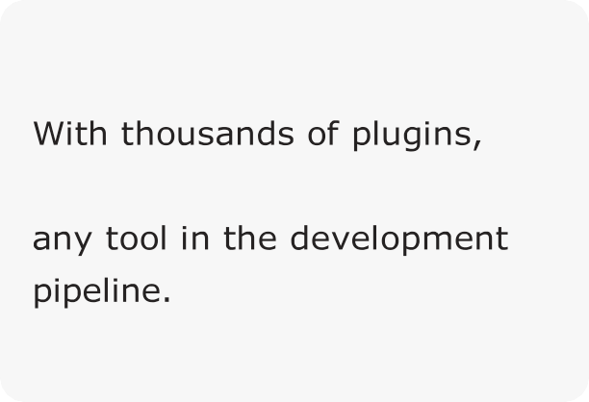
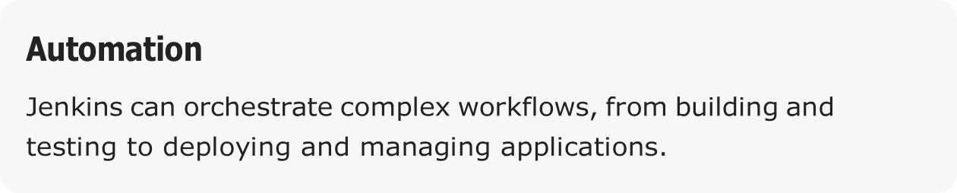
Understanding Jenkins
Extensibility
Jenkins integrates with virtually
Server
Jenkins is an open-source automation server central to modern DevOps practices. It supports continuous integration and delivery, enabling teams to automate various stages of the software development lifecycle. Jenkins is highly configurable through its web interface or Jenkinsfile.

Slide 5
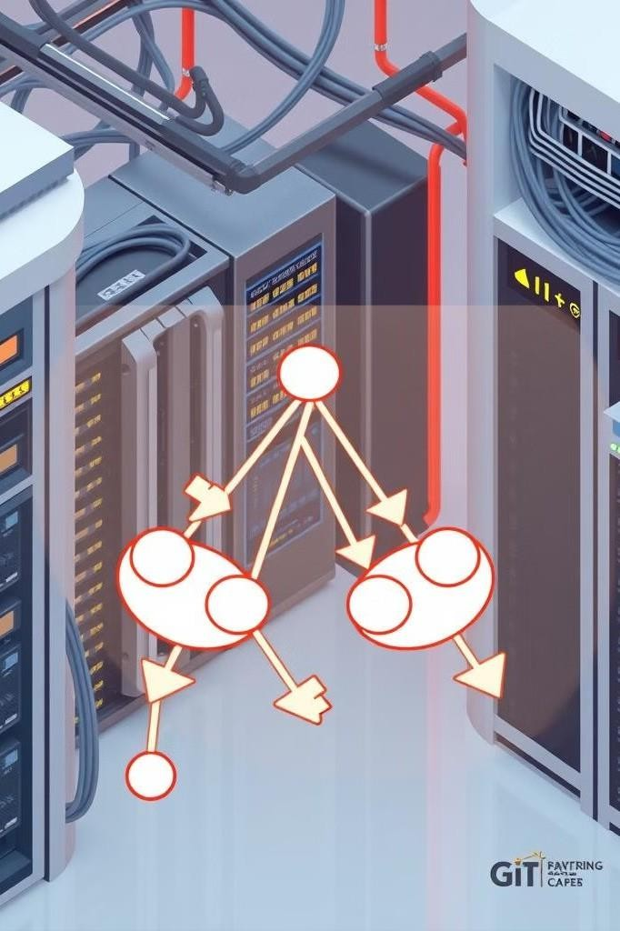



Git-Based Infrastructure Management
Infrastructure as Code (IaC)
Manage infrastructure resources using code, allowing version control, review, and automated deployments.
Version Control with Git
Track changes, collaborate, and maintain a history of infrastructure configurations using Git.
Automated Workflows
Trigger infrastructure deployments and updates using Git- based workflows with tools like Jenkins.
Leveraging Git for infrastructure management enables version control and collaboration. Infrastructure as Code (IaC) principles allows you to define and manage infrastructure resources using code stored in Git repositories.

Slide 6
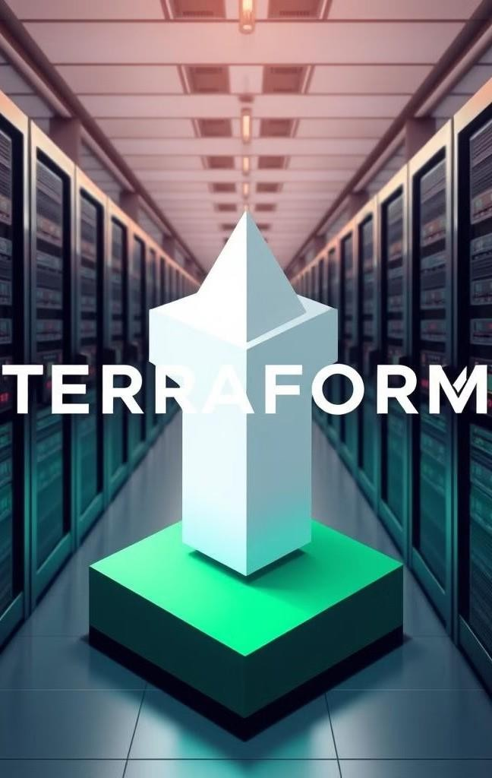

Introduction to Terraform
Infrastructure Provisioning
Terraform enables you to define and provision infrastructure resources across various cloud providers and on-premises environments.
Declarative Configuration
You describe the desired state of your infrastructure, and Terraform automatically figures out how to achieve it.
State Management
Terraform tracks the state of your infrastructure, allowing you to manage changes and dependencies effectively.
Terraform is an Infrastructure as Code tool that enables you to define and provision infrastructure resources using a declarative configuration language. It supports multiple cloud providers and on-premises environments. Terraform helps with provisioning, changing, and versioning infrastructure safely and efficiently.

Slide 7
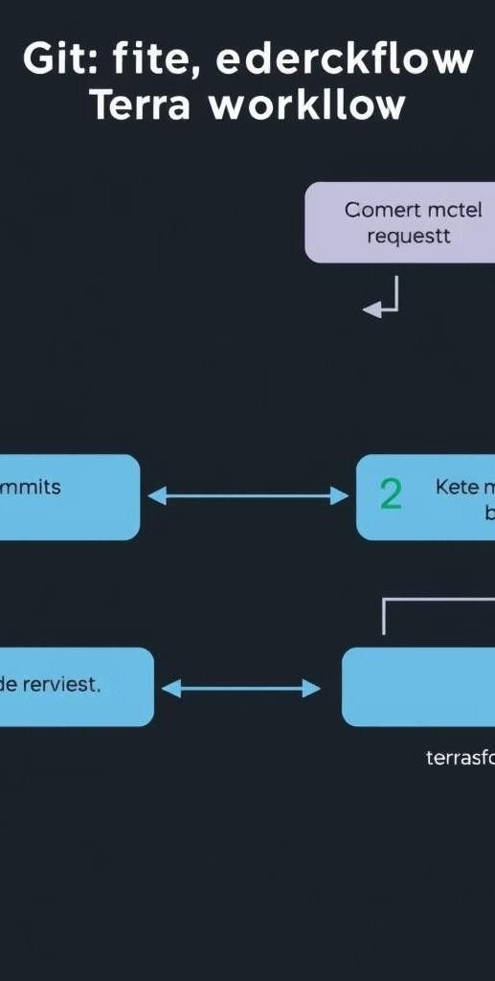
Terraform in Git Workflow
Code Changes
Make changes to Terraform configuration files and commit them to a Git repository.
2
Pull Request
Create a pull request to propose the changes and initiate a review process.
Automated Testing
Jenkins automatically runs Terraform plan to validate the proposed changes and identify potential issues.
4
Apply Changes
Upon approval, Jenkins executes Terraform apply to provision or update the infrastructure resources.
Incorporate Terraform into a Git workflow using pull requests and automated testing. Jenkins can be configured to run Terraform plan on pull requests to validate the changes and then execute Terraform apply upon approval. This approach promotes collaboration and reduces the risk of errors.

Slide 8
Benefits of Git-Based Infrastructure
Version Control
Track all changes to infrastructure configurations, allowing you to revert to previous states if needed.
Collaboration
Enable team collaboration through pull requests, code reviews, and automated testing.
Auditability
Maintain a complete audit trail of infrastructure changes, ensuring compliance and accountability.
Git-based infrastructure management offers several advantages, including version control, collaboration, auditability, and automated testing. It allows you to manage infrastructure resources as code, enabling consistent and repeatable deployments.

Slide 9
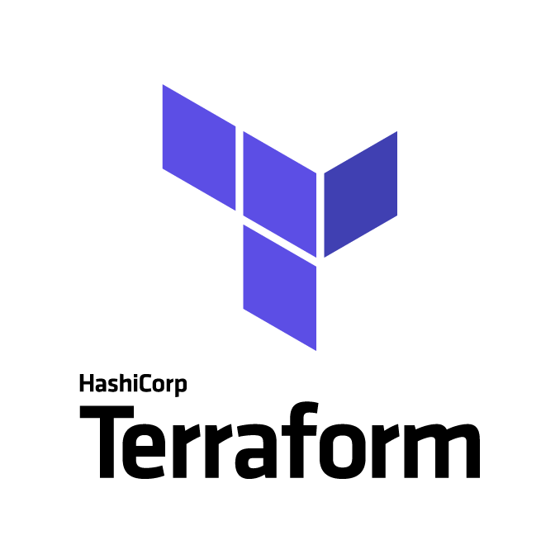

Key Takeaways and Next Steps
Jenkins for Automation
Leverage Jenkins for continuous integration and delivery, including automated email alerts and Terraform deployments.
Terraform for IaC
Use Terraform to define and provision infrastructure resources as code.
Git for Version Control
Manage infrastructure configurations in Git repositories, enabling version control, collaboration, and auditability.
By integrating Jenkins, Terraform, and Git, you can establish a robust infrastructure management system that promotes automation, collaboration, and compliance. Next steps include implementing these practices in your environment and continuously refining your workflows.

Slide 10
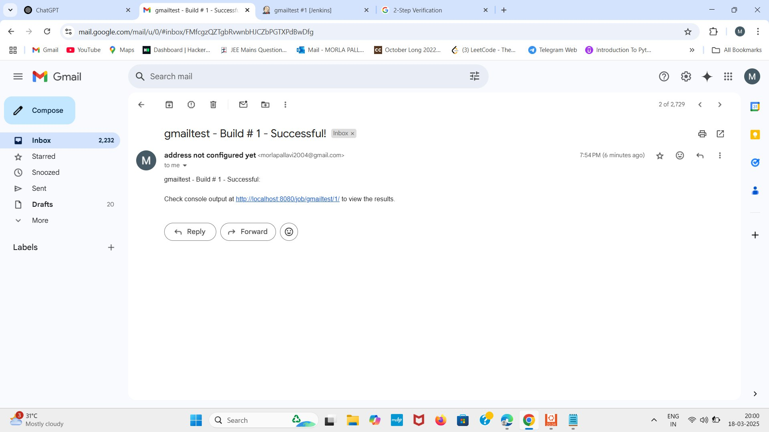
OUTPUT SCREENSHOTS:

Slide 11
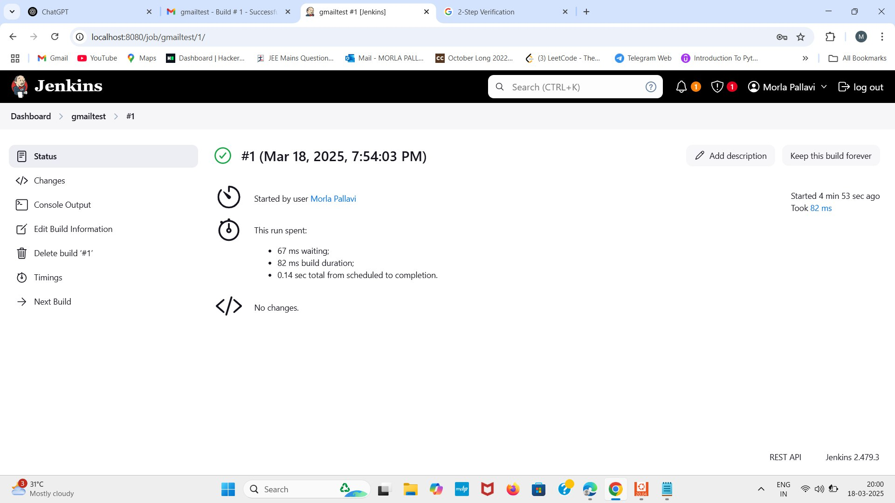

Slide 12


